Slide 1



FPT Software
ANDROID TRAINING
LESSON 7
Version 0.1

Slide 2
Agenda
Content Provider Basics
Accessing a Content Provider
Developing a Custom Content Provider
2/11/2012
Android Insights - 3
<number>/18

Slide 3
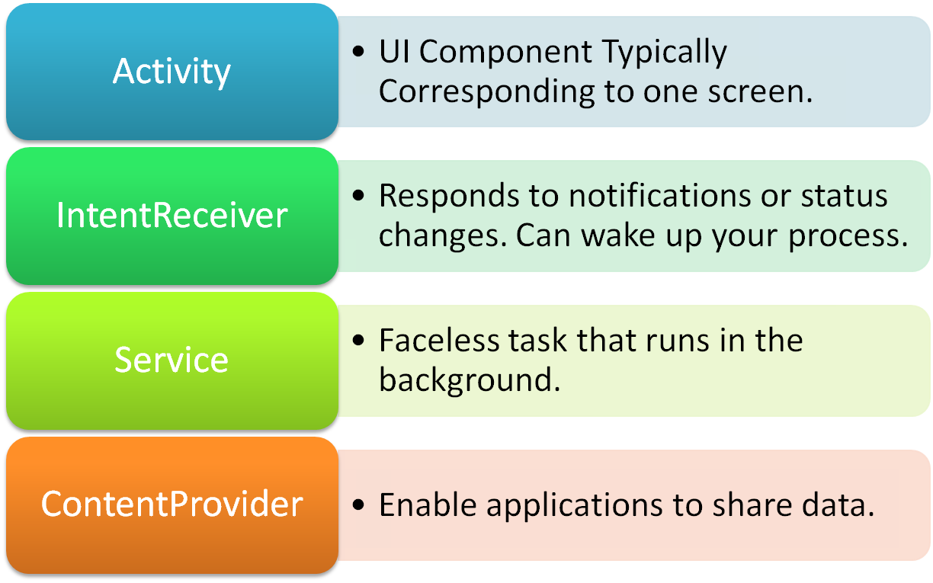
Application Building Blocks

Slide 4
Android Application Anatomy
Activities
Provides User Interface
Usually represents a Single Screen
Can contain one/more Views
Extends the Activity Base class
Services
No User Interface
Runs in Background
Extends the Service Base Class
Application= Set of Android Components
Intent/Broadcast Receiver
Receives and Reacts to broadcast Intents
No UI but can start an Activity
Extends the BroadcastReceiver Base Class
Content Provider
Makes application data available to other apps
Data stored in SQLite database
Extends the ContentProvider Base class

Slide 5
Broadcast Receivers
A broadcast receiver is a component that responds to system-wide Broadcast announcements.
A broadcast receiver is registered as a receiver in an Android Application via the AndroidManifest.xml file, or You can also register BroadcastReceiver dynamically via the Context.registerReceiver() method.
Many broadcasts originate from the Android system—for example, a Broadcast announcing that the screen has turned off, the battery is low, or a picture was captured or an SMS is received.

Slide 6
Broadcast Receivers
A broadcast receiver will be able to receive intents which can be generated via the Context.sendBroadcast() method.
The class BroadcastReceiver defines the onReceive() method. Only during this method your BroadcastReceiver object will be valid, afterwards the Android system can recycle the BroadcastReceiver. Therefore you cannot perform any asynchronous operation in the onReceive() method. .

Slide 7
Pending Intent
A PendingIntent is a token that you give to another application (e.g. Notification Manager, Alarm Manager or other 3rd party applications), which allows this other application to use the permissions of your application to execute a predefined piece of code.
To perform a broadcast via a pending intent so get a PendingIntent via PendingIntent.getBroadcast().
To perform an activity via an pending intent you receive the activity via PendingIntent.getActivity().

Slide 8
Pending Intent
There are three static PendingIntentfactory methods which can be used to obtain a PendingIntent
  public static PendingIntent getActivity(Context context, int requestCode, Intent intent, int flags)
  public static PendingIntent getBroadcast(Context context, int requestCode, Intent intent, int flags)
  public static PendingIntent getService(Context context, int requestCode, Intent intent, int flags)
These return PendingIntent instances which can be used to
  start an activity,
  perform a broadcast, or
  start a service
Depending upon the given arguments each of these methods can either
  create a new PendingIntent object,
  modify an existing PendingIntent object,
  modify an existing PendingIntent object and create a new PendingIntent object, or
  do nothing

Slide 9

Broadcast Receivers
We’ll use a Broadcast Receiver to capture SMS receive event
We capture the SMS receive event and launch an Activity to show the sms and give user
an option to reply the SMS
Activity
OS
BroadcastReceiver

Slide 10
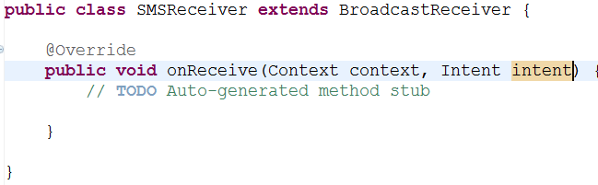
Broadcast Receivers
Create a new project BroadcastReceiverDemo
A broadcast receiver is implemented as a subclass of BroadcastReceiver and each
  broadcast is delivered as an Intent object. In this case the intent is detected by
  android.provider.Telephony.SMS_RECEIVED
  To do this we’ll create a class SMSReceiver that extends BroadcastReceiver class and define the method onReceive()
BroadcastReceiver

Slide 11
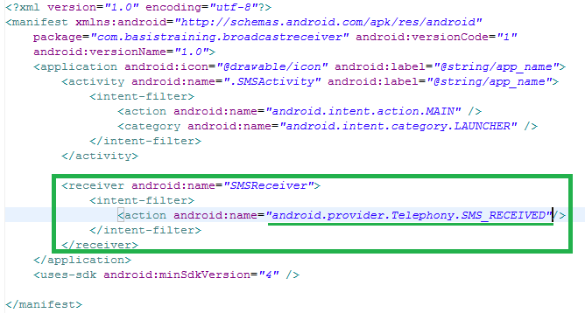
Broadcast Receivers
  3. We also need to add SMSReceiver as receiver of a particular Intent (SMS received) which is identified by android.provider.Telephony.SMS_RECEIVED
BroadcastReceiver

Slide 12
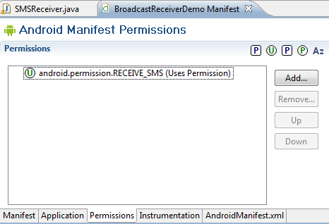
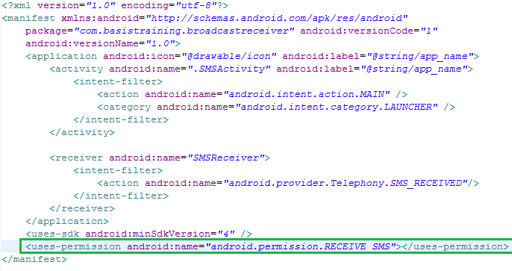
Broadcast Receivers
  4. Also we have to add permission for receiving SMS
BroadcastReceiver

Slide 13
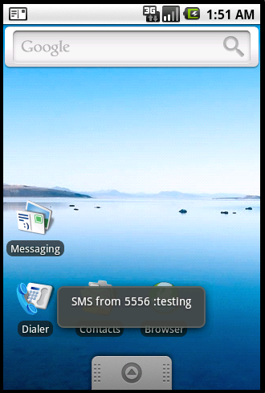
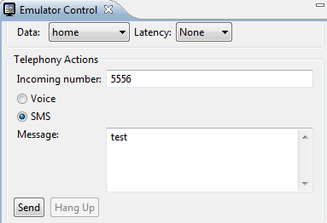
Broadcast Receivers
  5. Now we run the application
  6. Now we use emulator control to send sms

Slide 14
Receiving SMS
Bundle bundle = intent.getExtras();
SmsMessage[] msgs = null;
String str = "";
String address="";
if (bundle != null)
{
//---retrieve the SMS message received---
Object[] pdus = (Object[]) bundle.get("pdus");
msgs = new SmsMessage[pdus.length];
for (int i=0; i<msgs.length; i++)
{
msgs[i] = SmsMessage.createFromPdu((byte[])pdus[i]);
str += "SMS from " + msgs[i].getOriginatingAddress();
str += " :";
str += msgs[i].getMessageBody().toString();
str += "\n";
address=msgs[i].getOriginatingAddress();
Toast.makeText(context, str, Toast.LENGTH_LONG).show();
}

Slide 15

Sending SMS
1. Add permission in menifest.xml
2. We add the following code for sending SMS from anywhere of our application

Slide 16
Services
it runs in the same process as the application it is part of.
To create a application to run in the background of other current activities, one needs to create a Service. The Service can run indefinitely (unbounded) or can run at the lifespan of the calling activity(bounded).

Slide 17
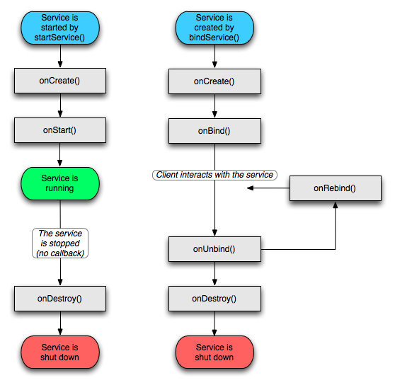
Services

Slide 18
Services
a Service has a different lifecycle than activities therefore have different methods. But to begin a service in the application a call to startService() which envokes the service onCreate() method and onStart() beginning running the service.
context.startService() | ->onCreate() - >onStartCommand() [service running]
Calling the applications stopService() method to stop the service.
context.stopService() | ->onDestroy() [service stops]
context.onBindService() | ->onCreate() [service created] . The client will receive the IBinder object that the service returns from its onBind(Intent) method, allowing the client to then make calls back to the service.

Slide 19
Homework
Create SMS application:
  Display incoming phone number
  Quick reply
  close

Slide 20
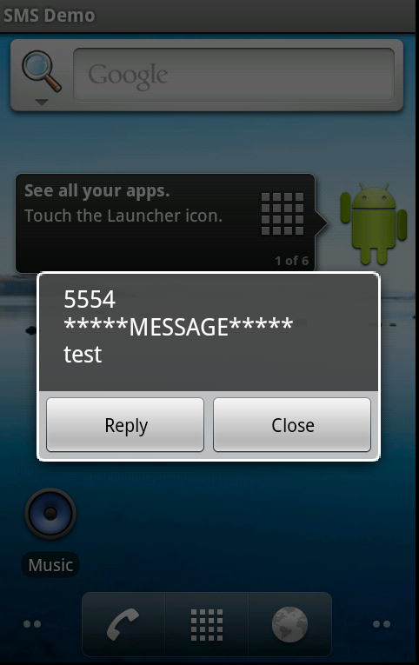
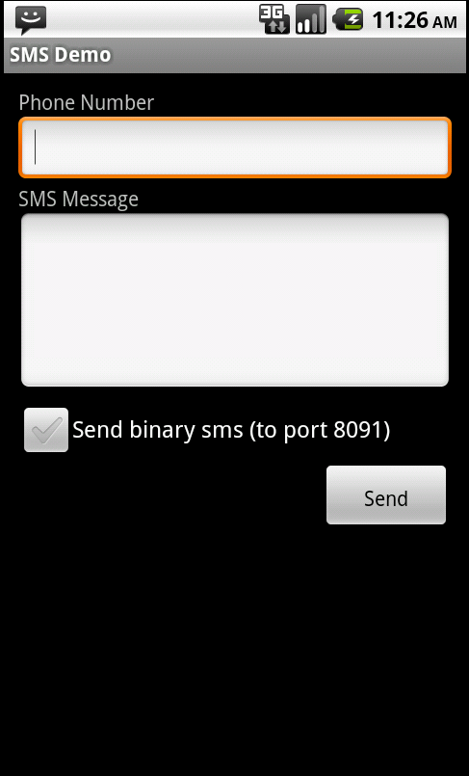
Homework

Slide 21
Thank you!

